Slide 1
E-COMMERCE WEBSITE
GROUP J
PARMINDER SINGH (758193)
MANINDER SINGH(765489)
AMAN NAIN(765118)

Slide 2
Objective
People can buy products through our website. It makes the things much easier as individuals can save their money by comparing the price of products as well as they can save their time.
GITHUB LINK:
https://github.com/amannain/E-commerce-website.git

Slide 3
Work done by:
Registration Page (Aman Nain)
Login Page (Maninder Singh)
Dashboard (Parminder Singh)

Slide 4
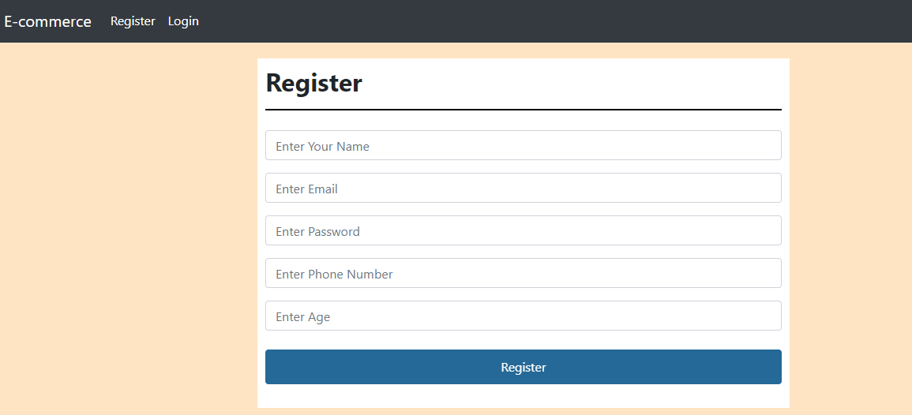

Slide 5
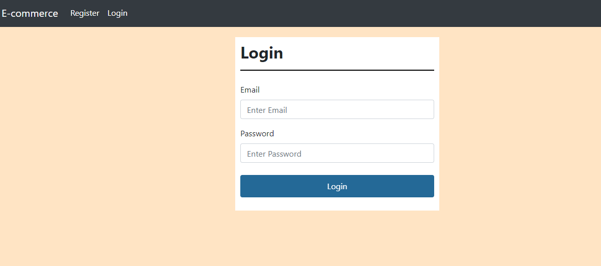

Slide 6
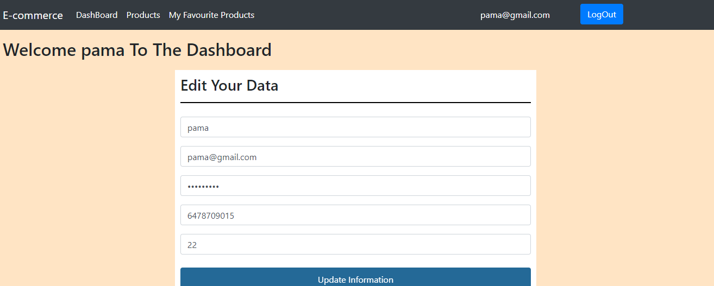

Slide 7
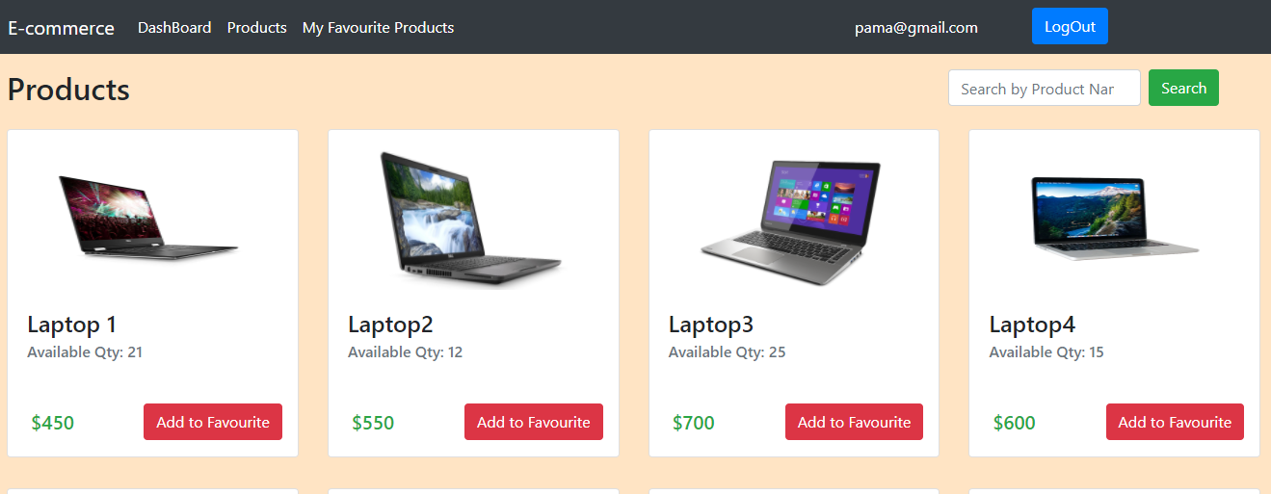

Slide 8
THANK
YOU

